Slide 1
AWS ECS and ECR
Notes:
https://courses.cs.washington.edu/courses/cse403/13au/lectures/git.ppt.pdf
http://enos.itcollege.ee/~jpoial/allalaadimised/git/getting-started-with-git.pdf

Slide 2
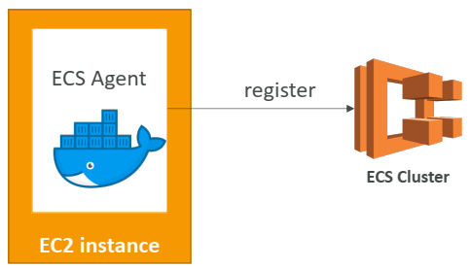
ECS Clusters Overview
ECS Clusters are logical grouping of EC2 instances
EC2 instances run the ECS agent (Docker container)
The ECS agents registers the instance to the ECS cluster
The EC2 instances run a special AMI, made specifically for ECS

Slide 3
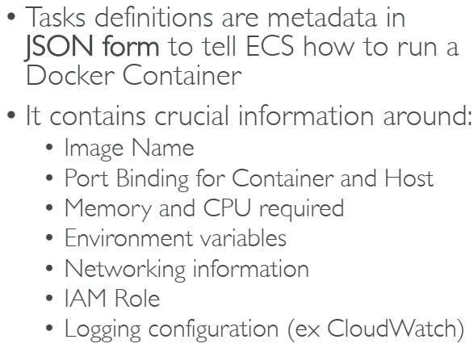
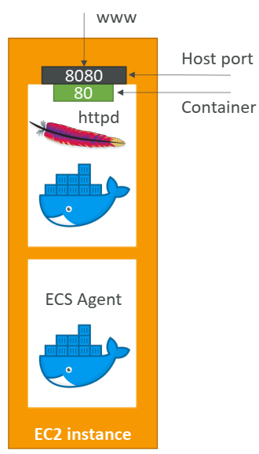
ECS Task Definitions
Port

Slide 4
ECS Service
ECS Services help define how many tasks should run and how they should be run
They ensure that the number of tasks desired is running across our fleet of EC2 instances.
They can be linked to ELB / NLB / ALB if needed

Slide 5
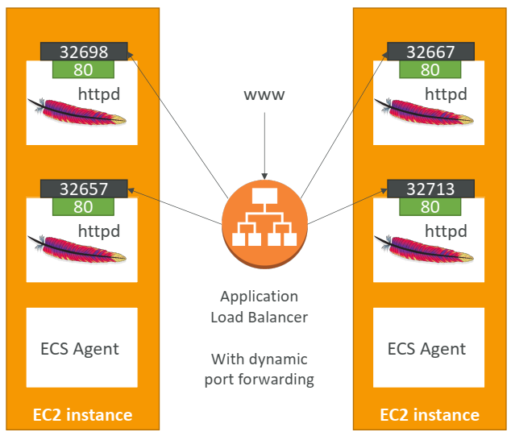
ECS Service with Load Balancer

Slide 6
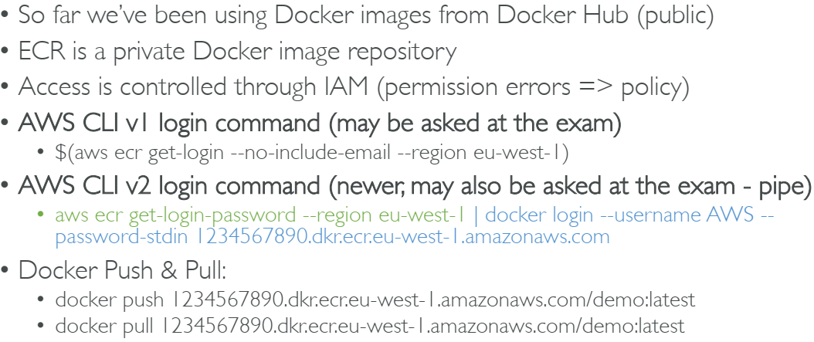
ECR

Slide 7
Fargate
When launching an ECS Cluster, we have to create our EC2 instances
If we need to scale, we need to add EC2 instances
So we manage infrastructure…
With Fargate, it’s all Serverless!
We don’t provision EC2 instances
We just create task definitions, and AWS will run our containers for us
To scale, just increase the task number. Simple! No more EC2

Slide 8
Thanks

